Slide 1
DO NOW QUESTIONS (5 pts)
SOCRATIVE.COM
‘LimeburnerRoom’
(One word)

Slide 2
KEY ISSUE 2 Conclusion
Why is Each Point on Earth Unique?

Slide 3
Let’s Test Ourselves Over Regions: When the region on the left pops up, you decide if it is Formal, Functional, or Perceptual
Region:
Formal, Functional, or Perceptual?
State of Nebraska
Amazon River basin
Dixie
The Sun Belt
Lancaster County
Country of Brazil
The I-84 corridor
Red Sox Nation
Formal
Functional
Perceptual
Perceptual
Formal
Formal
Functional
Perceptual

Slide 4
Regions of Culture
CULTURE is the body of beliefs, traits, and social forms that together constitute the distinct tradition of a group of people.
Origin is Latin cultus, which means “to care for.”

Slide 5
Two geographical definitions of culture.
1.) What People Care About
Ideas, beliefs, and values
Language, religion, Ethnicity.
2.) What People Take Care Of
Production of material wealth, food, clothing, and shelter.
Notes:
Geographers can answer questions, such as why some areas have high cancer rates, by looking for spatial associations with the distributions of cultural traits.

Slide 6
Key Issue 3 – Why are different places similar?

Slide 7
Geographers attempt to explain why similarities among places are not coincidental.
Notes:
Globalization means that the scale of the world is shrinking, not literally in size, of course, but in the ability of a person, object, or an idea to interact with a person, object, or idea in another place.

Slide 8
Scale of analysis
LOCAL -> GLOBAL Common scales include local, regional, national, and global.

Slide 9
BEWARE- SCALES (of analysis) CAN LIE.
Somethin’ that seems true at ONE scale might not be from ANOTHER.

Slide 10
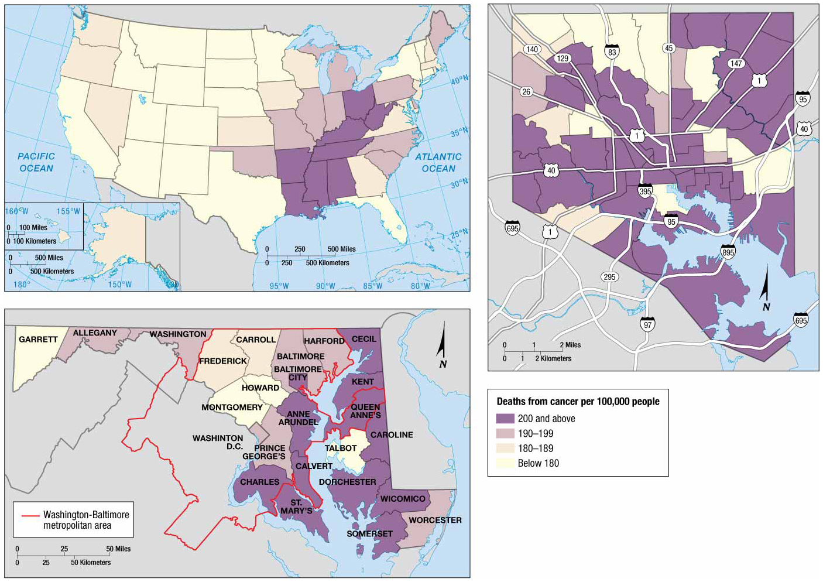

Slide 11
Increasingly, geographers are concerned with the GLOBAL scale.
Technology has changed our world, bringing people ‘closer’ together and making patterns more routine.

Slide 12
Globalization is the ‘shrinking’ of the world- not literally, but in terms of interaction and diffusion.
Interaction between disparate places is becoming more common than ever before.

Slide 13
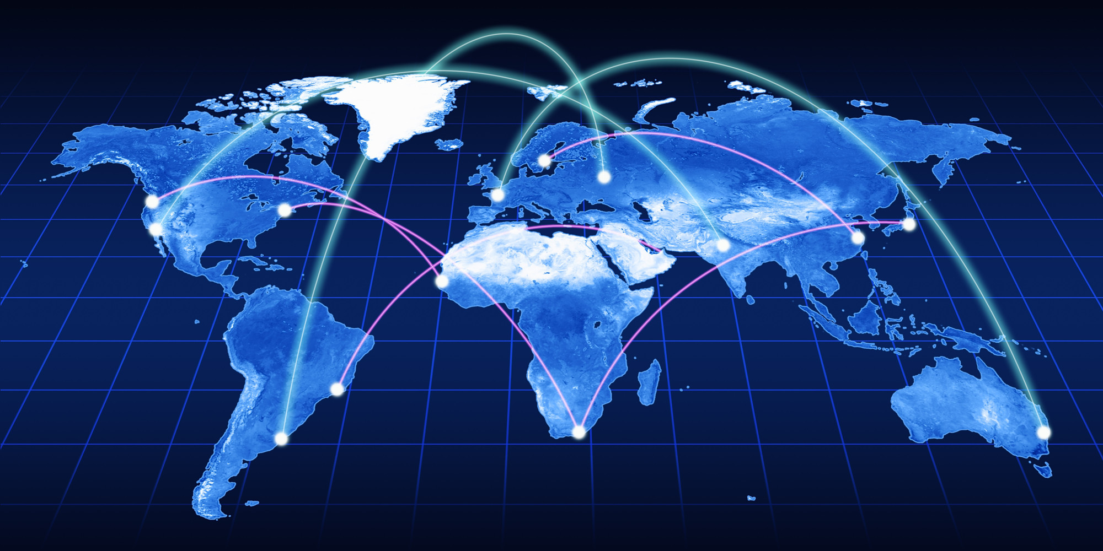

Slide 14
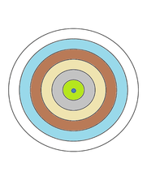
Spatial Interaction
The farther away someone is from you, the less likely you two are to interact with one another
Trailing-off phenomenon of diminishing contact with the increase in distance is called distance decay.
Notes:
The increasing gap in economic conditions between regions in the core and periphery that results from the globalization of the economy is known as on uneven development.

Slide 15
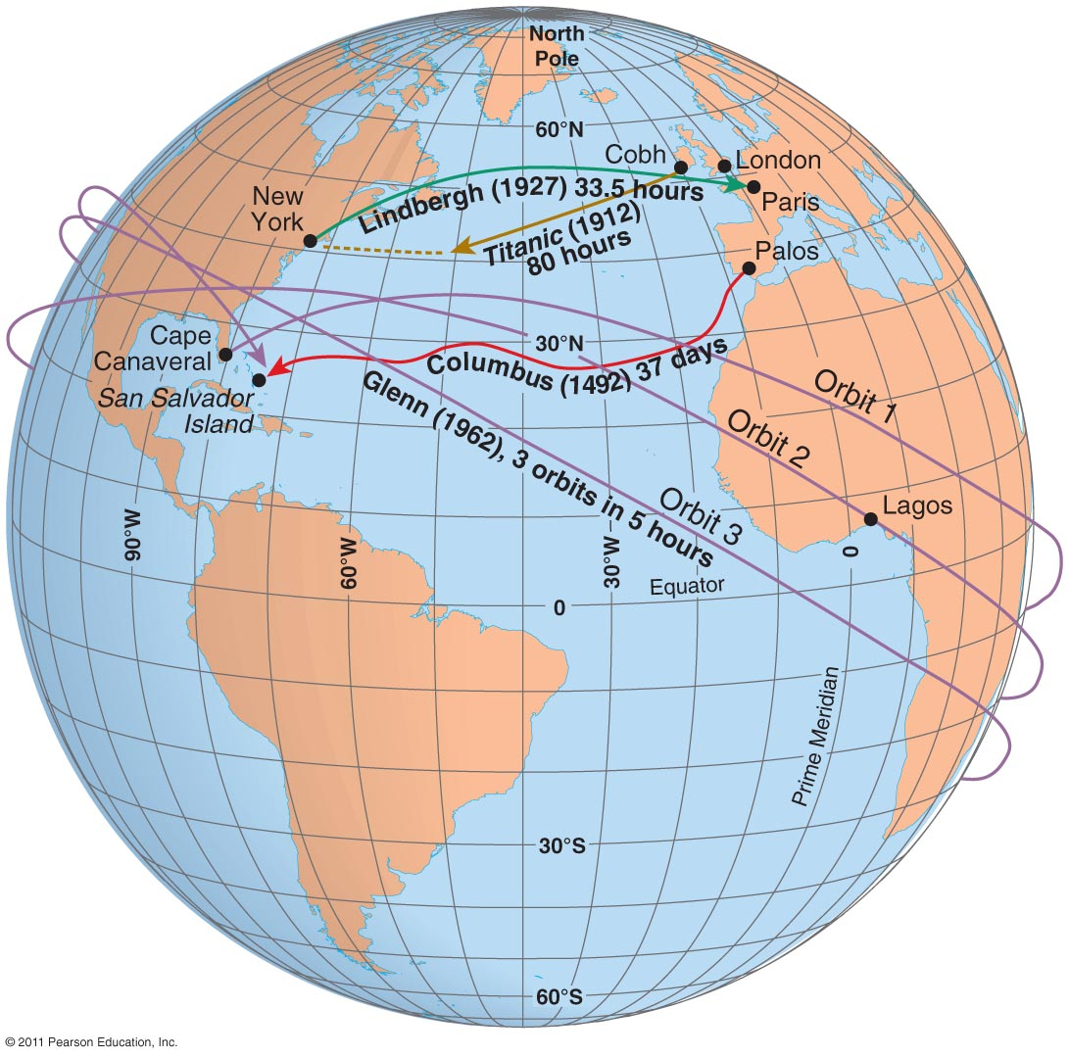
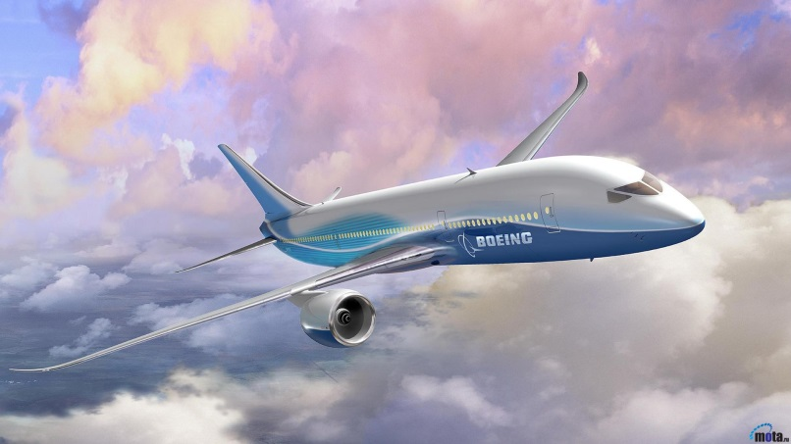
Space-Time Compression:
Reduction in time it takes for something to reach another place.
KEY element of Globalization.

Slide 16
The Dark Side
There are some much-despised elements of globalization. Let’s quickly look at a couple.

Slide 17
Economic issues in one part of the world are increasingly likely to cause ‘ripples’ throughout the rest of the system, as economies grow ever more interdependent.

Slide 18
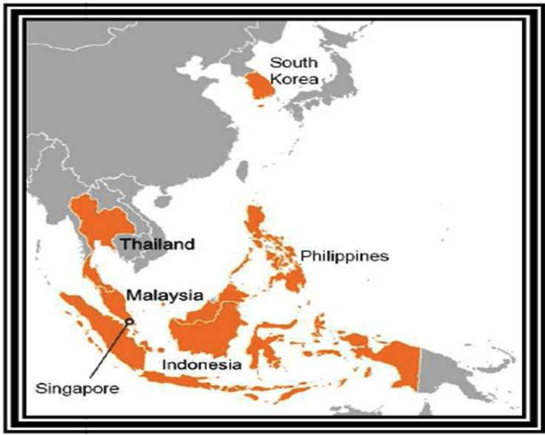
Example of economic ‘ripple’ effect:
The ASIAN CONTAGION of 1997

Slide 19
Example #2:
CHINESE STOCK MARKET CRASH of 2015

Slide 20
Within days of Chinese markets plummeting, the Dow Jones average- the biggest US stock index- had its biggest single-day fall, ever.

Slide 21
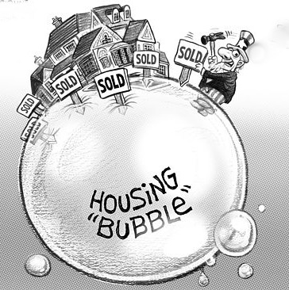
A HOUSING BUBBLE is when house prices build up to an unsustainable level. When it ‘pops,’ home values fall and many people are left ‘UNDERWATER.’
This last happened in 2009.

Slide 22
Who are the primary agents of GLOBALIZATION?

Slide 23
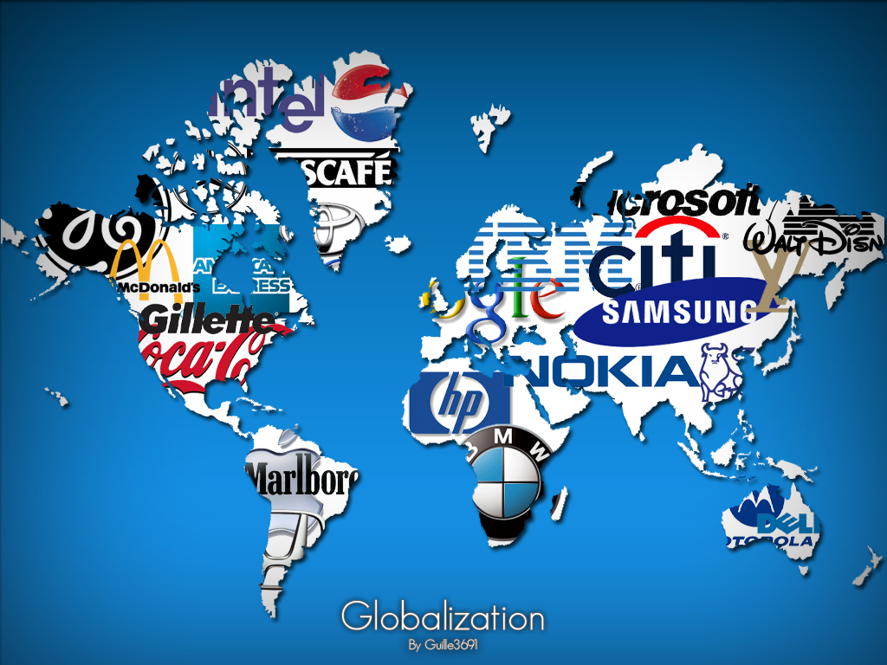

Slide 24
TRANSNATIONAL CORPORATIONS are huge companies that divide their activities between different countries and regions in order to maximize profit.
They remain lucrative by correctly assessing the best location for their activities based on local conditions.

Slide 25
TNCs have fostered the establishment of a global division of labor.

Slide 26
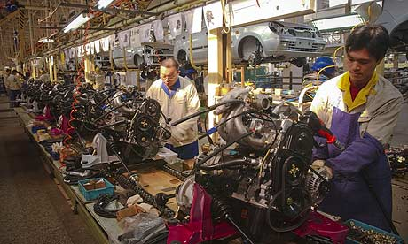

Slide 27
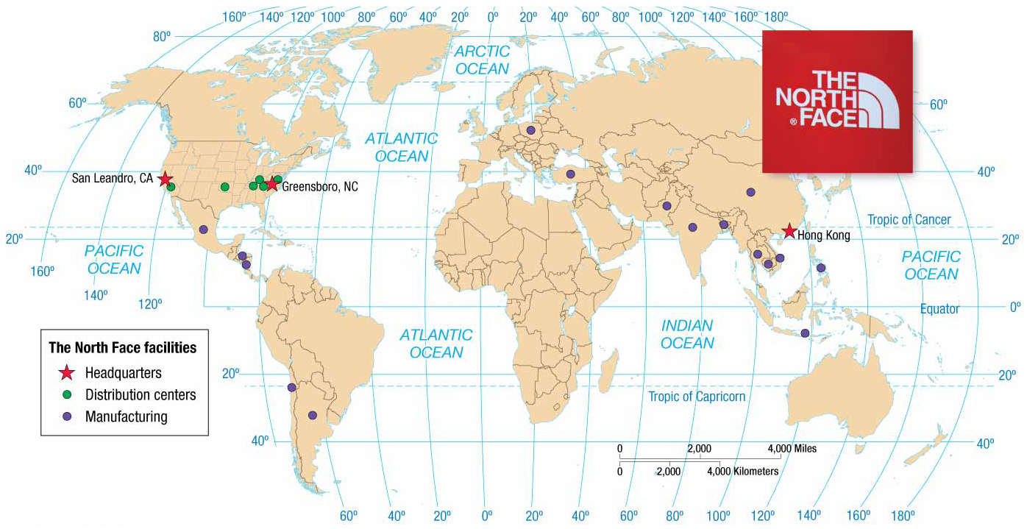
Economic activities are regionalized – including production and consumption

Slide 28
When two regions of Earth each fill a role needed by the other, this is called COMPLEMENTARITY

Slide 29
Globalization of Culture
Increasingly uniform cultural preferences produce uniform landscapes of material artifacts and cultural values.
In other words, people all around the world want to have what WE* have- and to live the way WE* live. * the developed world

Slide 30
Fast-food restaurants, service stations, and retail chains deliberately create a visual appearance that differs as little as possible.

Slide 31
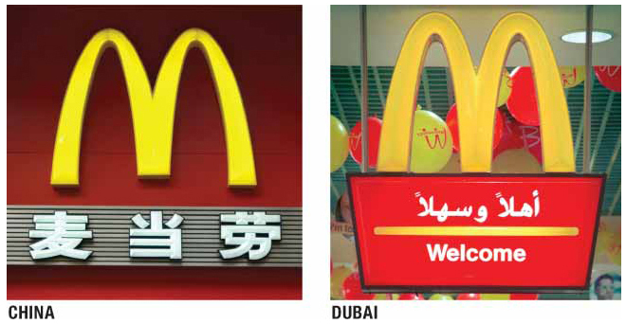
Notes:
Figure 1-23 GLOBALIZATION OF CULTURE McDonald’s has more than 32,000 restaurants in 117 countries. To promote global uniformity of its restaurants, the company erects signs around the world that include two golden arches.

Slide 32
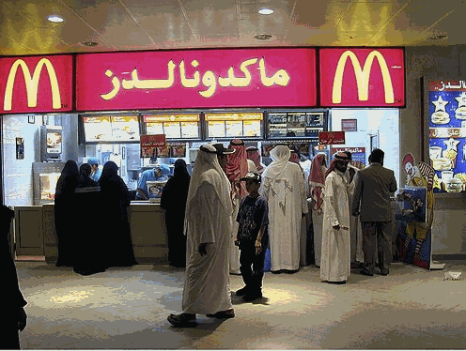
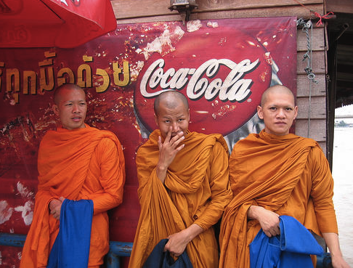
Cultural Diffusion
Cultural diffusion or spatial diffusion is the spread of an idea or innovation from its source to other cultures.
Diffusion occurs through the movement of people, goods or ideas.

Slide 33
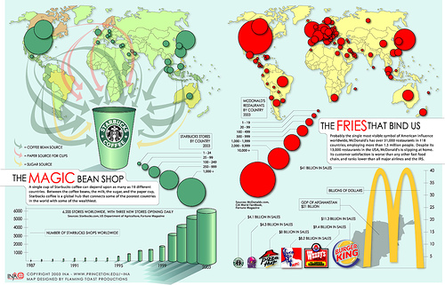

Slide 34
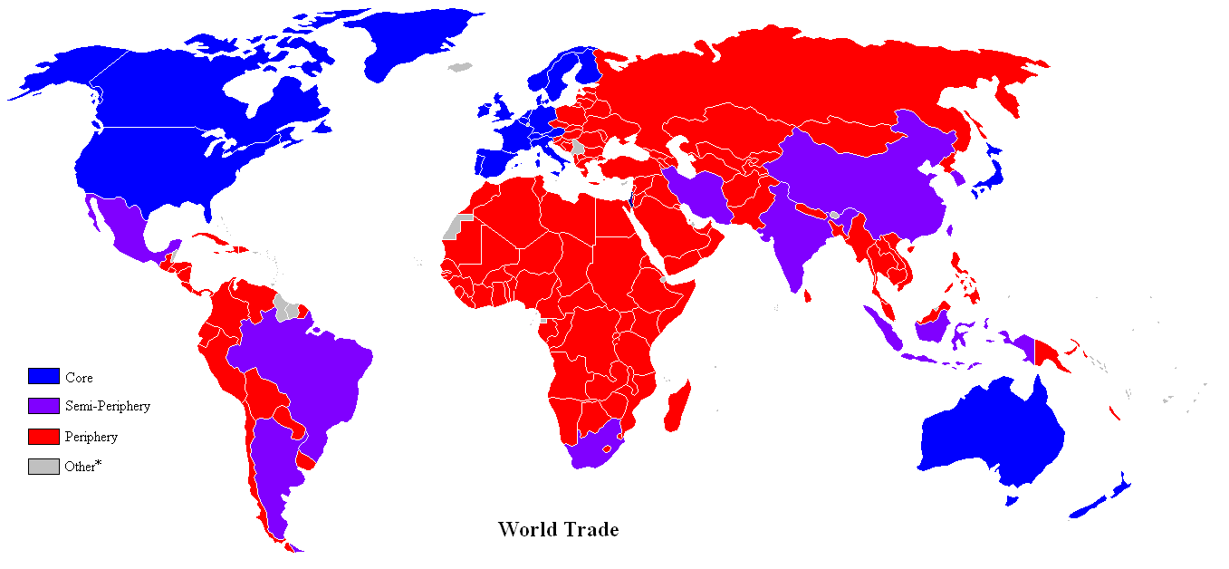
Core: North America, Western Europe, and Japan.
Semi-Periphery: India, China, Brazil Iran, Mexico
Periphery: Africa, Asia, and Latin America CORE-PERIPHERY DIVISION OF THE WORLD

Slide 35
Tear out a piece of paper. In the next 5 minutes, draw a very simple map of your neighborhood. Try to include as many locations as possible (parks, houses, stores, churches, etc). DO NOT LOOK AT A MAP.
ACTIVITY BREAK…….

Slide 36
Mental maps are maps in our minds of places we have been
Activity spaces are those places we travel to routinely in our daily cycles.
Mental maps include terra incognita, unknown lands that are off limits to our imagination.

Slide 37
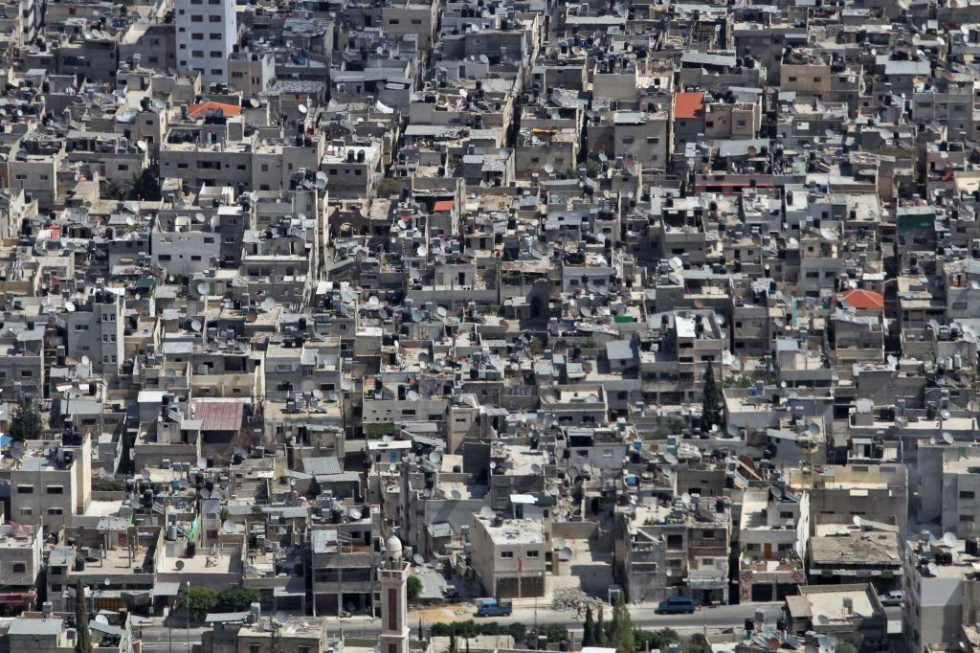
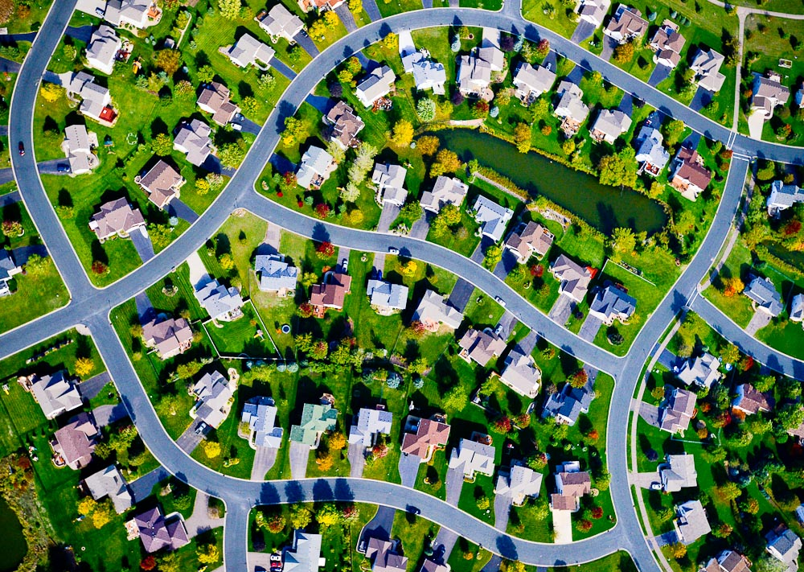
Space: Distribution of Features
Space refers to the physical gap or interval between two objects.

Slide 38
Space: Distribution of Features
3 Main properties of distribution
Density- frequency with which something occurs in space
Must be in a specified area (sq. km/mile usually)
Concentration- extent of a feature’s spread over space
Close together = clustered.
Relatively far apart = dispersed.
Pattern- geometric arrangement of objects in space

Slide 39
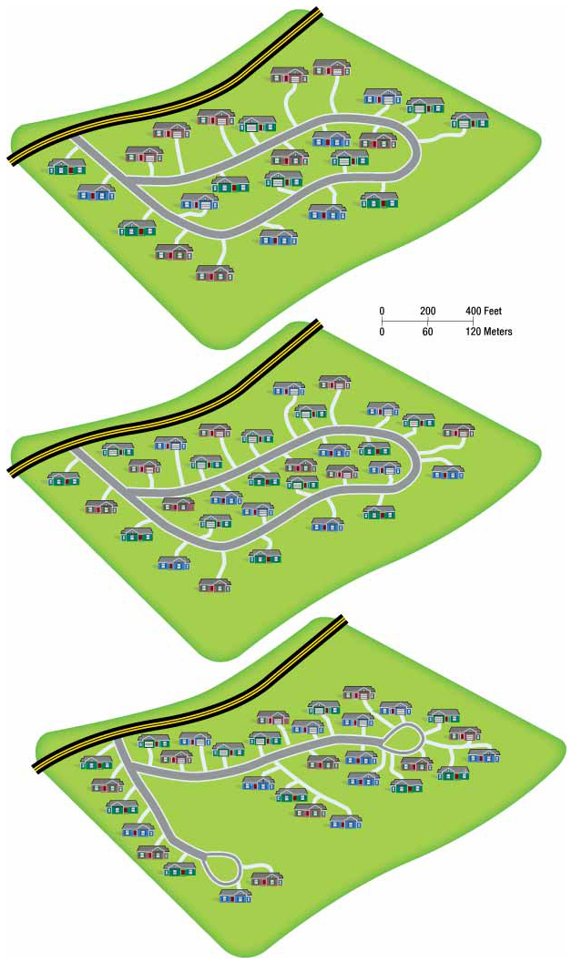
Distribution
Each of these three examples has the same DENSITY- the same amount of in the same given area.
Each, however, has a different CONCENTRATION. Each also has a different PATTERN.
Notes:
Figure 1-24 DISTRIBUTION OF HOUSES The top plan for a residential area has a lower density than the middle plan (24 houses compared to 32 houses on the same 82-acre piece of land), but both have dispersed concentrations. The middle and lower plans have the same density (32 houses on 82 acres), but the distribution of houses is more clustered in the lower plan. The lower plan has shared open space, whereas the middle plan provides a larger, private yard surrounding each house.

Slide 40
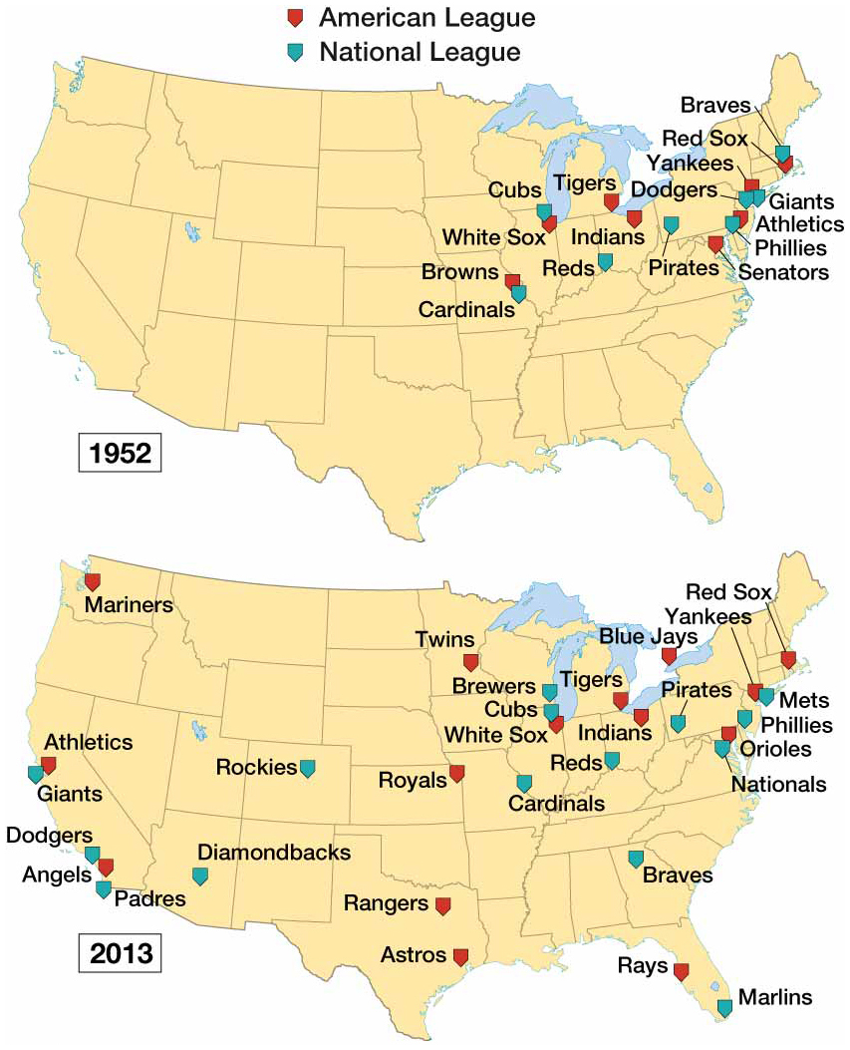
Notes:
FIGURE 1-25 DISTRIBUTION OF BASEBALL TEAMS The changing distribution of North American baseball teams illustrates the difference between density and concentration.

Slide 41
“The Township and Range System”
US Land Ordinance of 1785.
Each township is divided into 36 sections , 1x1mile each
Resulted in a grid-like pattern
The Homestead Act of 1863 encouraged the settlement of the West by giving each settler a quarter section or 160 acres of land.
Notes:
Not in book!!! Need to write down

Slide 42
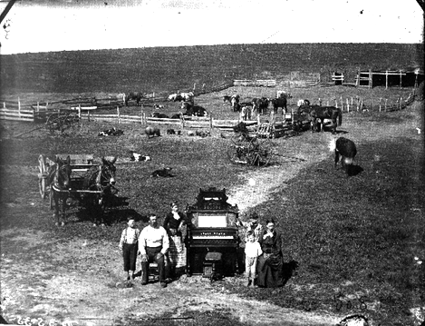

Slide 43
Iowa County Map – Example of Township and Range System

Slide 44
Cultural Identity in Space
The patterns people live along vary according to gender, ethnicity, sexuality, and other identity factors.
The local cultural landscape communicates to people what the accepted norm is within a place.
Ex. A bar or park that makes whites feel welcomed and people of color unwelcomed (or vice versa)
Ex. An inviting shopping district where people practicing alternative lifestyles flock, and where rainbow flags project a message of tolerance
Notes:
Humanistic geography is a branch of human geography that emphasizes the different ways that individuals perceive their surrounding environment.

Slide 45
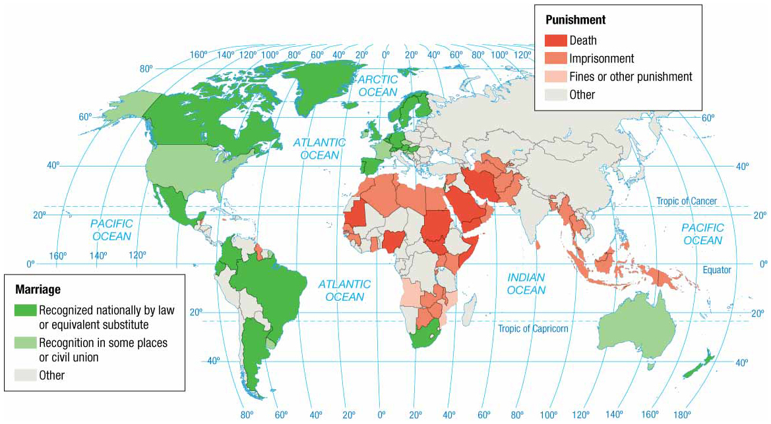
Notes:
FIGURE 1-30 SEXUAL DIVERSITY IN SPACE The International Lesbian, Gay, Bisexual, Trans and Intersex Association maps the distribution of laws that discriminate on the basis of gender. The harshest laws against male–male or female–female relationships are found in sub-Saharan Africa and Southwest Asia and North Africa. Laws supporting male–male or female–female marriage or equivalent substitute are found primarily in Europe and Latin America.

Slide 47
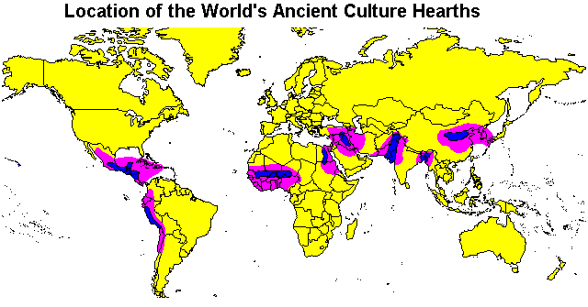
Hearths and Diffusion
Hearth:
a place from which something originates

Slide 48
Diffusion of People and Ideas
DIFFUSION:
Process by which a something spreads across space from one place to another.

Slide 49
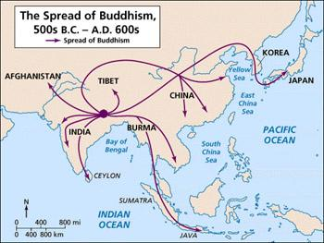
4 Types of Diffusion
Relocation Diffusion
Spread of an idea through movement of people from one place to another
Notes:
Connection refers to relationships among people and objects across the barrier of space.
Diffusion is the process by which a characteristic spreads across space from one place to another overtime.

Slide 50
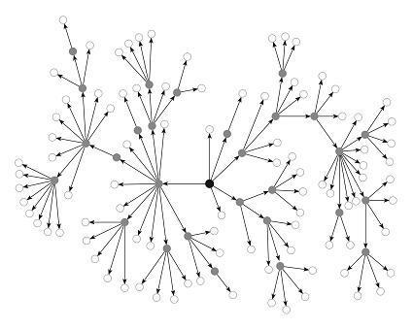
4 Types of Diffusion
2. Hierarchical diffusion:
spread of an idea from persons/nodes of authority down the ‘chain of power’
Ex: School (from principal), Military

Slide 51
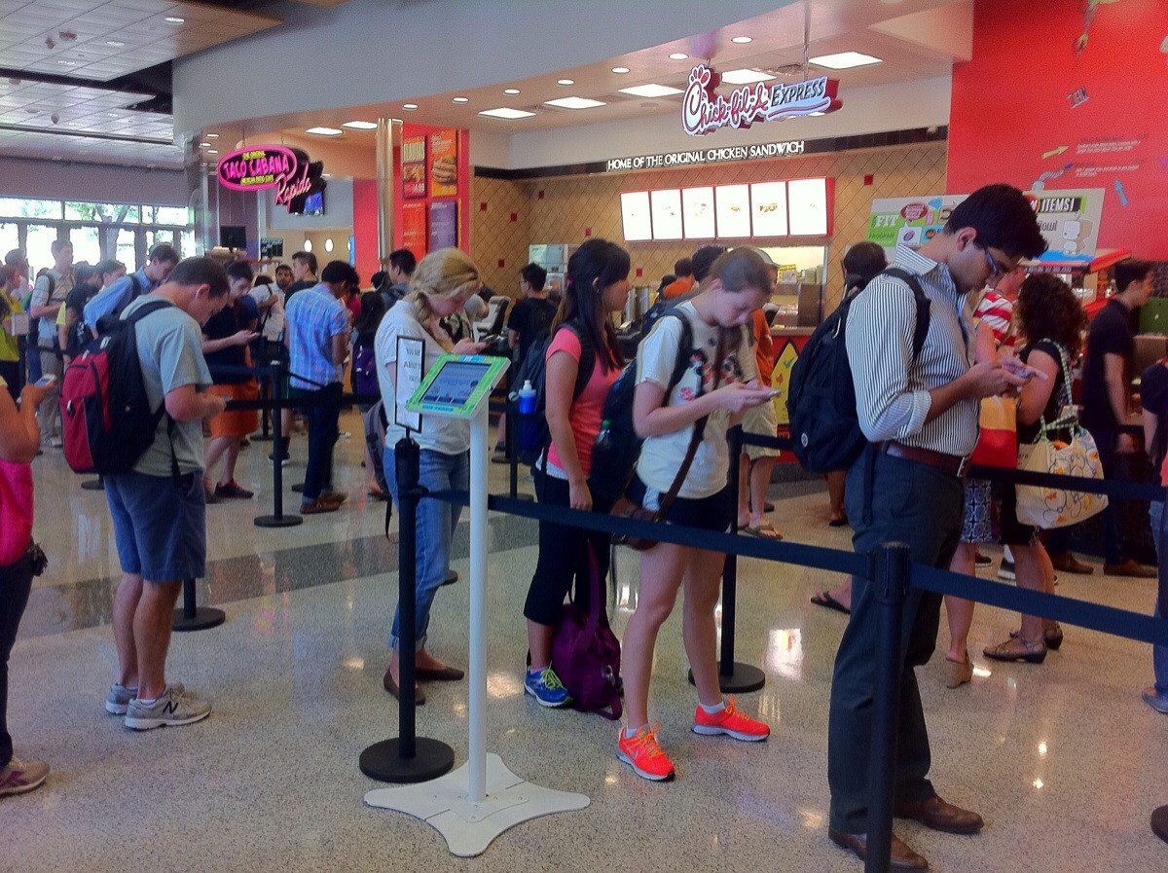
4 Types of Diffusion
3. Contagious diffusion: rapid, widespread diffusion of a characteristic throughout the population

Slide 52
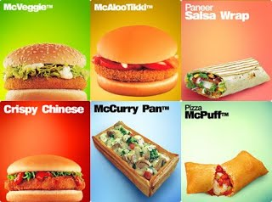
4 types of diffusion
4. Stimulus Diffusion
Spread of a strong underlying principle, though other elements fail to diffuse.
Notes:
Connection refers to relationships among people and objects across the barrier of space.
Diffusion is the process by which a characteristic spreads across space from one place to another overtime.

Slide 53
Upcoming…
TUES 9/22
Why are some human actions unsustainable?
Unit 1 Test STUDY GUIDE issued
THURS 9/24
UNIT 1 TEST

Slide 54
EXIT SLIP QUESTIONS (5 pts)
SOCRATIVE.COM
‘LimeburnerRoom’
(One word)

