Slide 1
Today’s Issues South America
Objectives:
Describe the uses of the rainforest. What’s out there that we don’t know about?
Discuss how destruction of the rainforest can be prevented.
Describe the struggle for democratic government in Latin America. Also, what conditions make a stable democracy?
Essential Question:
How is the rainforest an important global resource?

Slide 2
Rainforest Resources
The rain forest is an important global resource.
Its vegetation helps to clean the earth’s atmosphere, regulate the climate, and shelter several million species of plants, insects, and other wildlife.
Scientists have just begun to investigate and understand the rain forest’s biodiversity, its wide range of plant and animal species.
Yet, this variety of life is being destroyed at a rapid rate.
At the end of the 20th century, nearly 50 million acres of rain forest worldwide were being destroyed every year.

Slide 3
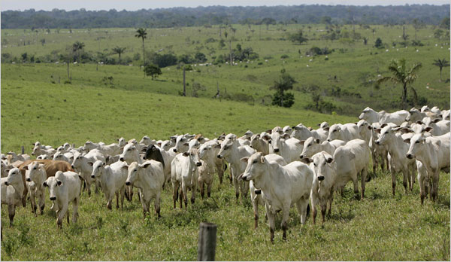
Why Clear the Rainforest?
The world’s demand for timber is great.
Mahogany and Cedar
Native peoples, living in poverty, travel into the rain forest in search of land on which they can grow crops.
They clear the forest, not realizing that the soil is not very fertile.
Cutting down the trees exposes the land to erosion.
Livestock, too, have been introduced into the rain forest.
Ranchers need land on which to graze their cattle, and by clearing the forests for pasture, they can produce a steady supply of beef for the export market.

Slide 4
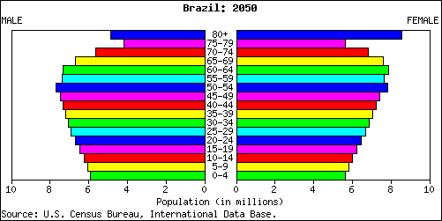
Population Pressures
Brazil 2010
Brazil’s growing population is contributing to the rain forest’s decline.
The estimated population of Brazil in 2000 was about 173 million people.
With an annual growth rate between half a percent and 1 percent, Brazil’s population is expected to reach 200 million by 2020.
With that many people to shelter, some developers want to build homes on land now covered by the rain forest.
Brazil 2050

Slide 5
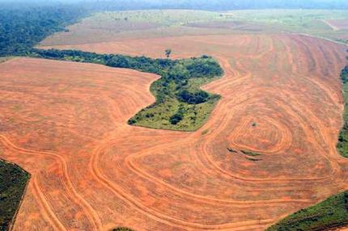
The Price of Destruction
There is a cost to pay for deforestation, cutting down and clearing away of trees, in the rain forest.
The short-term benefits are offset by the high price Latin America and the world are paying in damage to the environment.

Slide 6
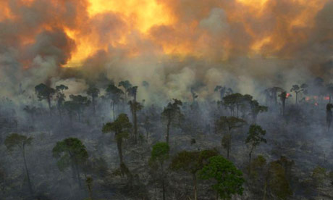
Environmental Concerns
Rain forests help to regulate the earth’s climate. They do this by absorbing carbon dioxide and producing oxygen.
As the forests disappear, much less carbon dioxide is absorbed. The carbon dioxide that is not absorbed builds up in the atmosphere.
This buildup prevents heat from escaping into space. The temperature of the atmosphere begins to rise, and weather patterns start to change.
By the beginning of the 21st century, evidence of this global warming appeared around the world, causing scientific concern.
A common method for clearing the rain forest, known as slash-and-burn, produces carbon dioxide and other harmful gases.

Slide 7
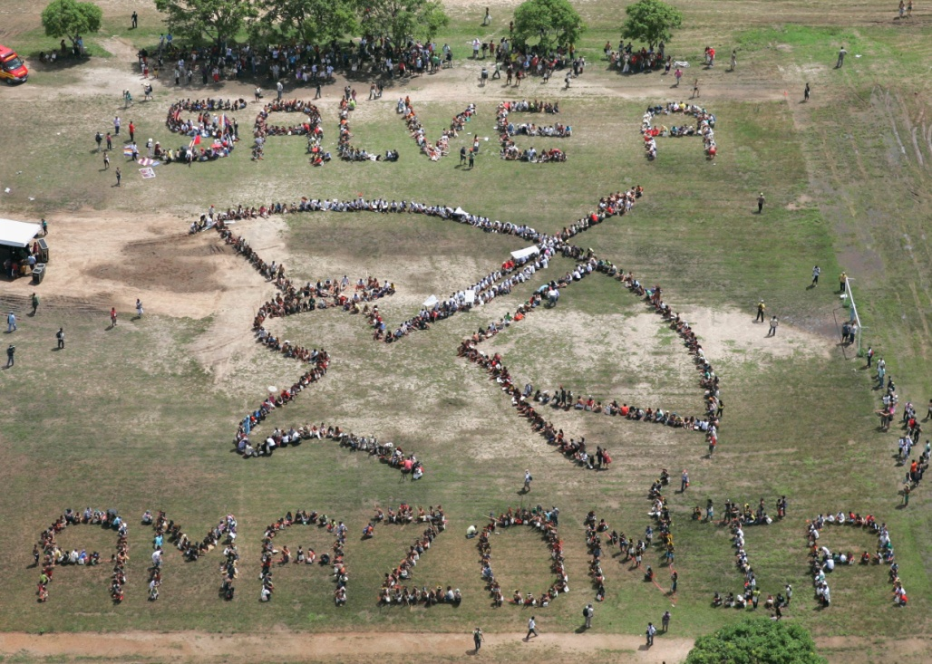
Solutions
A central problem facing many Latin American countries is how to balance competing interests.
Some countries in the region are attempting to restrict economic development until they can find the right balance between economic growth and the preservation of the rain forests.
Their mission is to educate people about the value of the rain forests and, when necessary, to organize protests against plans that would damage the environment.

Slide 8
Solutions
Some people think that since economic gain is at the heart of rain forest destruction, the affected governments should be paid to preserve the forests.
One such plan is known as a debt-for-nature swap. Many Latin American nations are burdened by tremendous debt. They’ve borrowed money to improve living conditions, and now they are struggling to pay it back.
In a debt-for-nature swap, an environmental organization agrees to pay off a certain amount of government debt. In return, the government agrees to protect a certain portion of the rain forest.
This approach was successful in Bolivia. There, an international environmental group paid off some government debt in exchange for the protection of an area of forest and grassland.
The battle to preserve the rain forests may be one in which everybody wins.

Slide 9
The Price of Democracy
Even in the 21st Century, Latin Americans today seek more democratic governments.
Democracy depends on free and fair elections, citizen participation, majority rule with minority rights, and guaranteed freedoms.
Latin America has shown little support for democratic rule until quite recently.
Her Excellency, Dilma Rousseff, the first female president of Brazil
President Cristina Fernández de Kirchner, Argentina’s first elected female leader.

Slide 10
Life After Colonialism
This government by the few, known as oligarchy, was not democratic.
The government censored the press, limited free speech, and punished dissent.
It also discriminated against all who were not part of the Spanish ruling class.
Elections were held, but there was never any doubt who was in charge.
If the government was unable to control the people, the military would step in, seize power, and form a new, harsher government known as a junta, which was run by the generals.
Chile was ruled by juntas until 1990.

Slide 11
The Caudillo
Throughout the 20th century, many Latin American countries were ruled by a caudillo, a military dictator or political boss, such as Juan Peron, in Argentina.
The caudillo’s support came from the military and the wealthy.
The caudillo was sometimes elected directly by the people.
For example, from the 1920s until the end of the 20th century, Mexico was governed by caudillos who were members of the Partido Revolucionario Institucional (PRI), or the Institutional Revolutionary Party.
Juna Peron and his 2nd Wife Eva
President Juan Peron and his 3rd wife Isabel Martínez de Perón. Isabel would go on to be South America’s first female ruler.

Slide 12
Establishing Stable Democracies
One goal of political reform is to establish constitutional government.
A freely-elected government that respects the law is the basis of democracy.
Participation of citizens in political affairs is also critical. This requires that people be well educated and provided with economic security.
Political and economic stability are two sides of the same coin.
A lack of prosperity is usually accompanied by social and political unrest.
Ecuador’s newly reelected President, Rafael Correa. President Correa handily won reelection on Sunday February 17, 2013.

